Slide 1
CITIBIKE AIN’T GOT FLOW Will Bartlett NYC Data Science Academy 2006 July Bootcamp

Slide 2
Objectives:
To visualize usage of citibikes by time.
Specifically, the flow of bikes into and out of individual stations.
To demonstrate citibike’s flow/distribution.

Slide 3
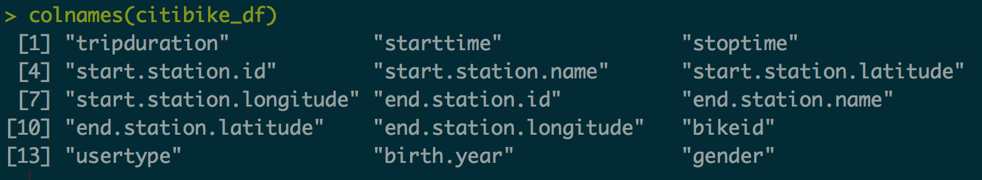
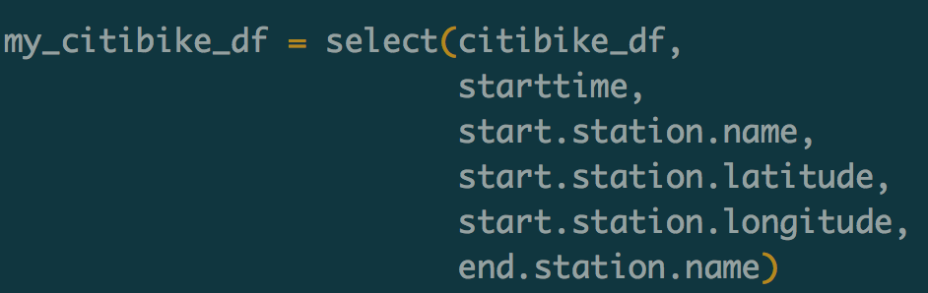
Data: Public CITIBIKE trip data for month of June, 2016 (Last Month). (n=1,460,318) *colnames returns the column names of the indicated data table.

Slide 4
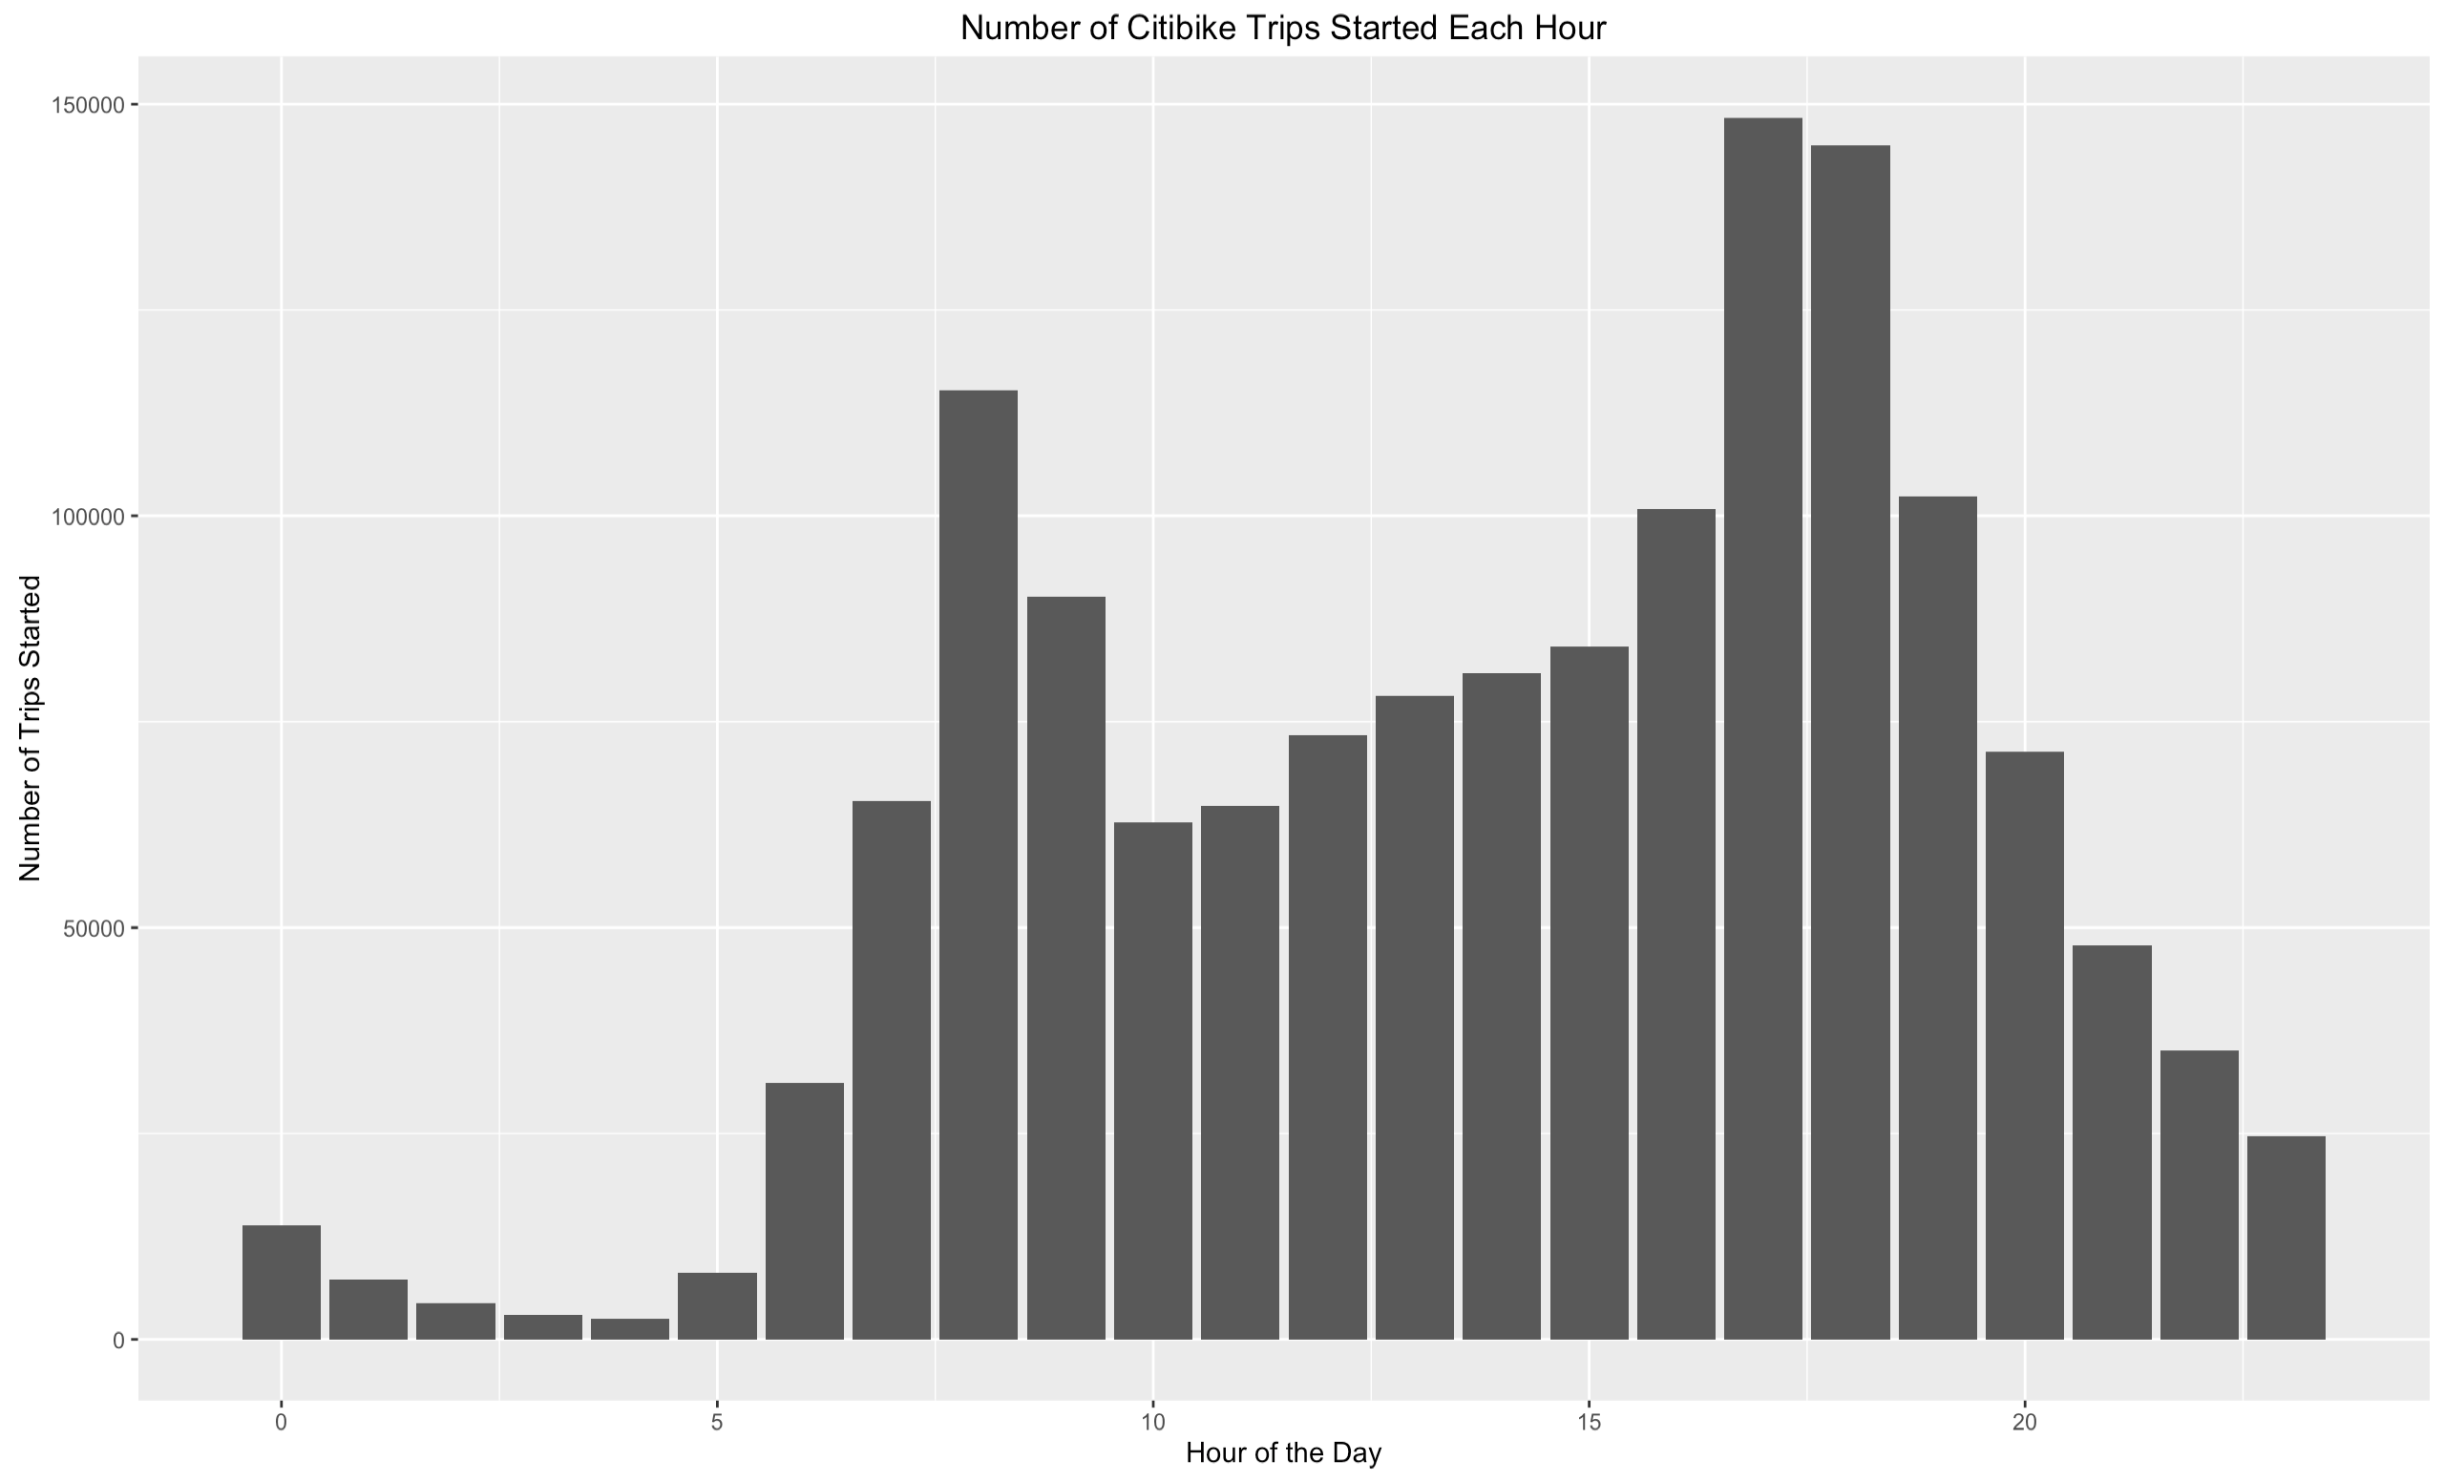

Slide 5
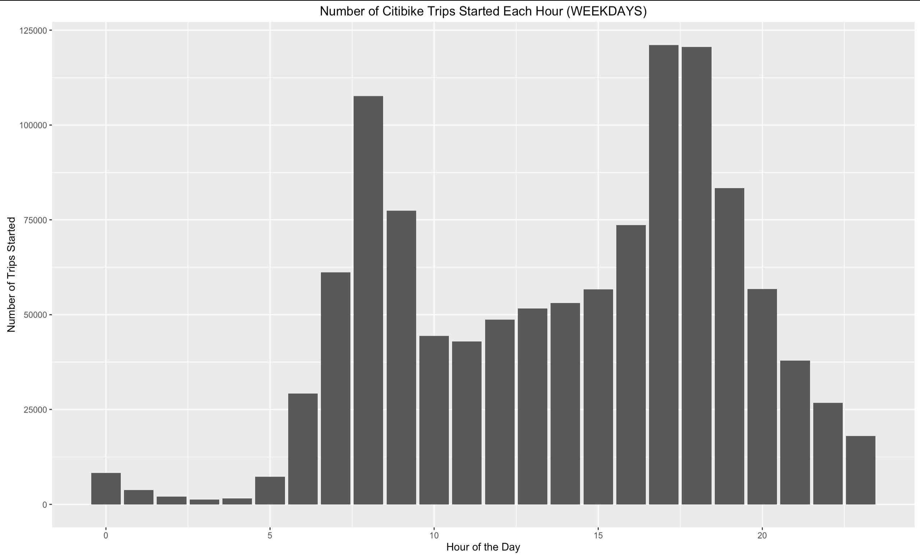

Slide 6
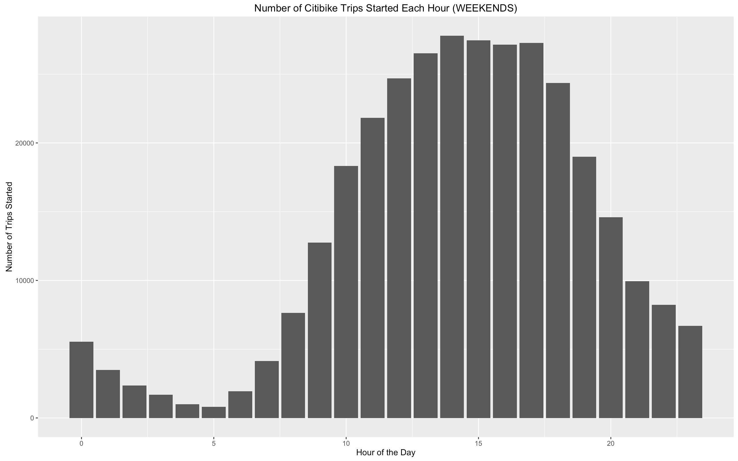

Slide 7
THE REST OF THE GRAPHICS SHOW WEEKDAY DATA

Slide 8
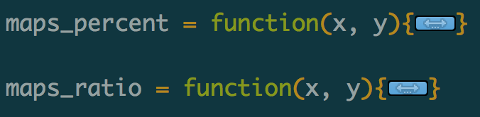
2 Functions…
maps_percent = creates a map that shows, for the given time window, the percentage of all trips that happened at each particular dock (~docks that get the most start traffic~).
maps_ratio = creates a map that shows, for the given time window, the ratio of starting trips to ending trips at each dock. (~flow balance of each dock~).

Slide 9
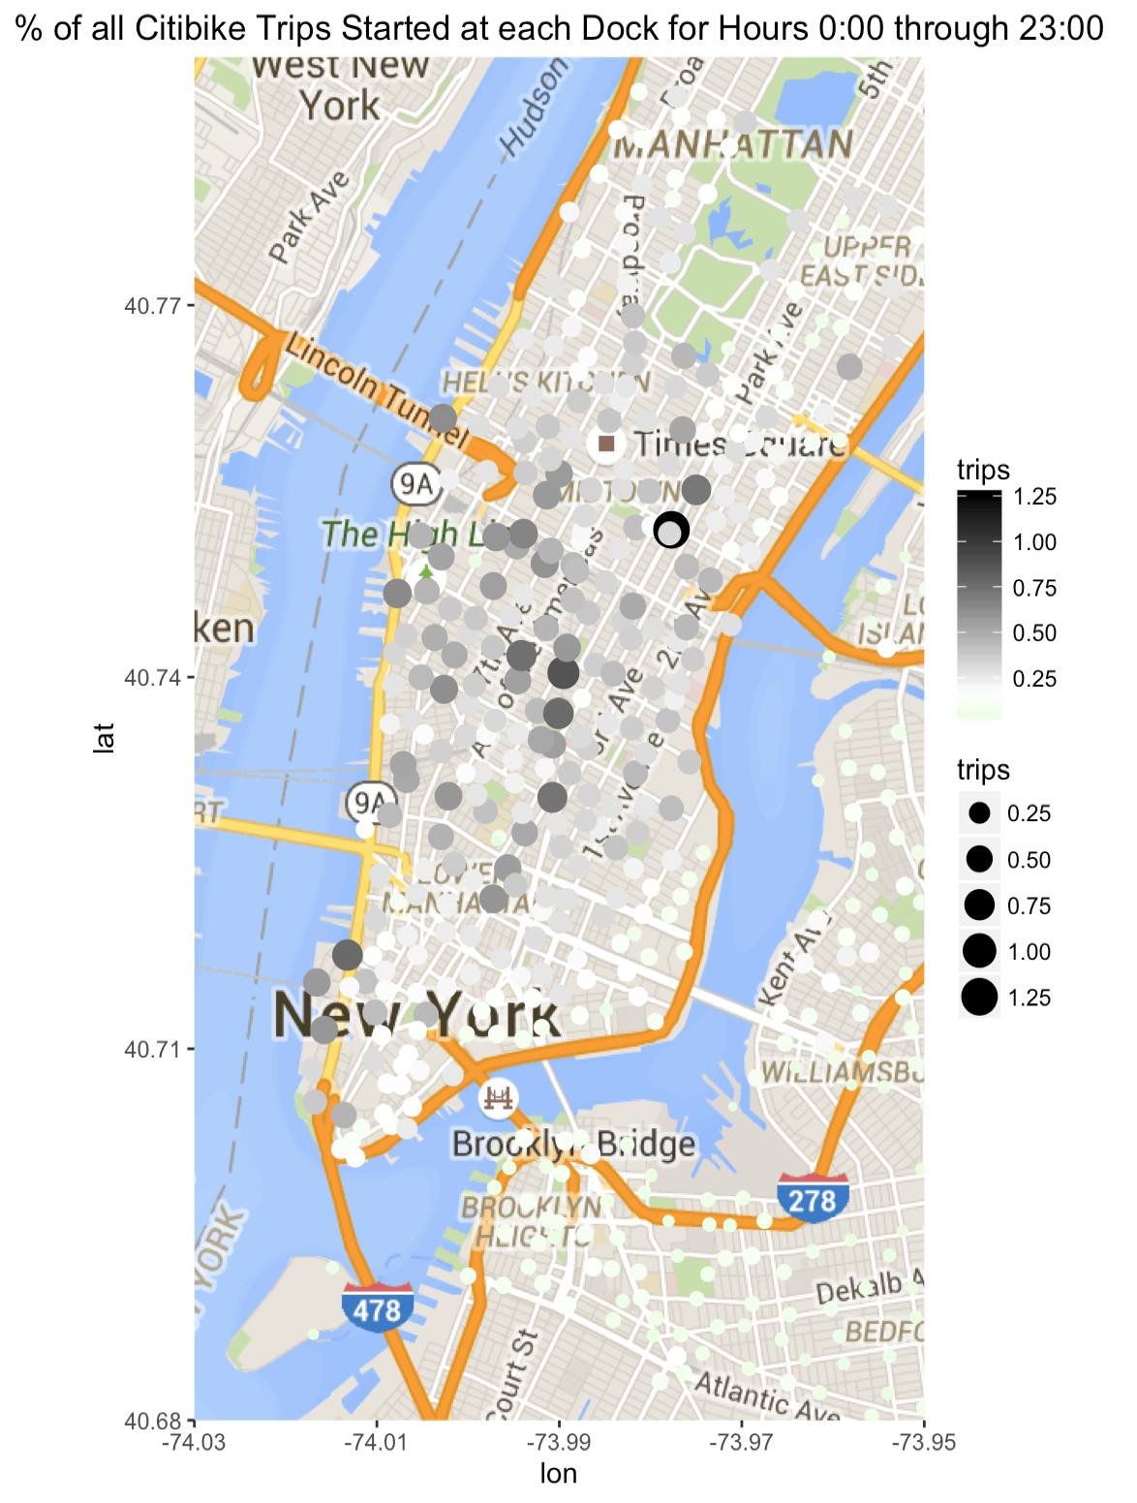
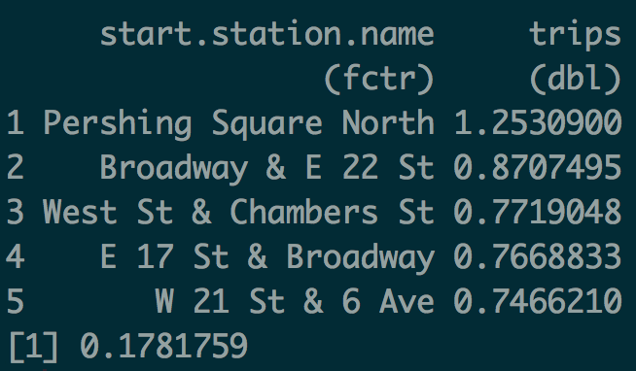

Slide 10
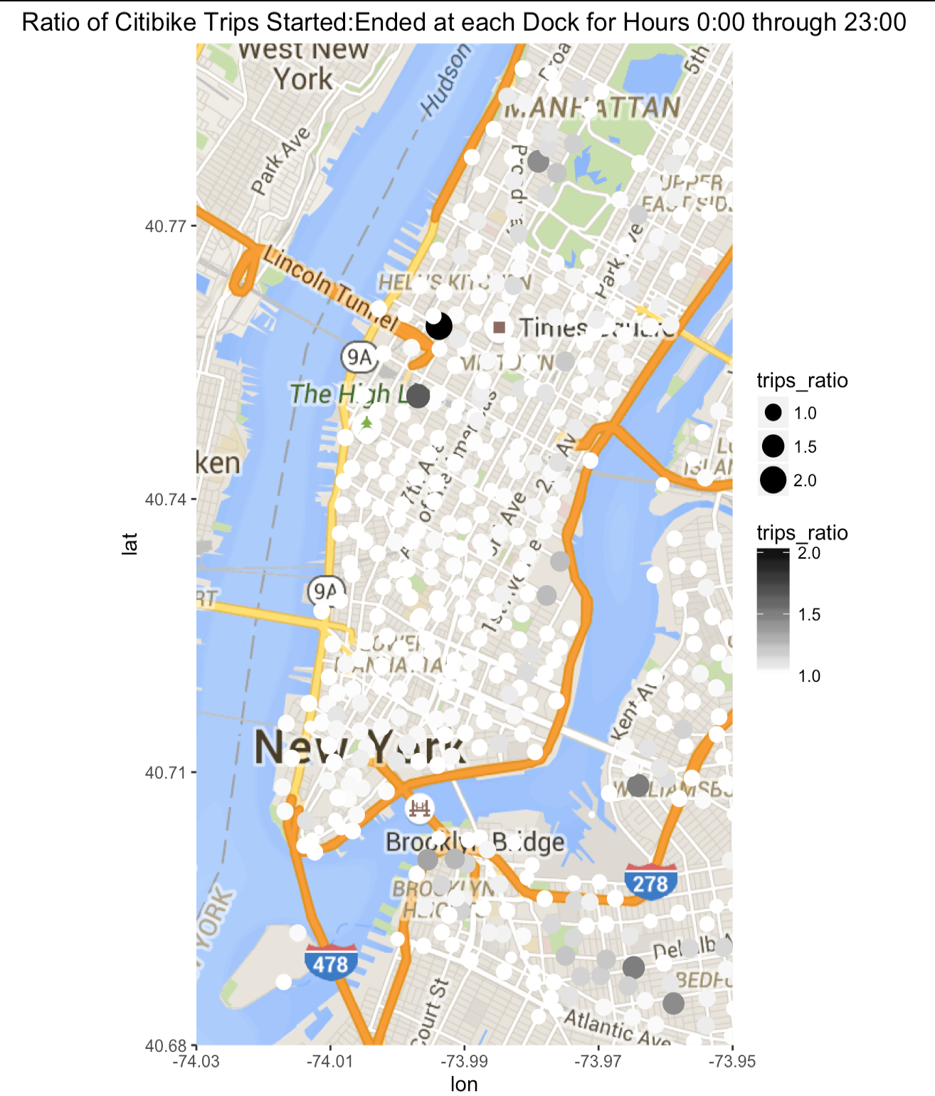
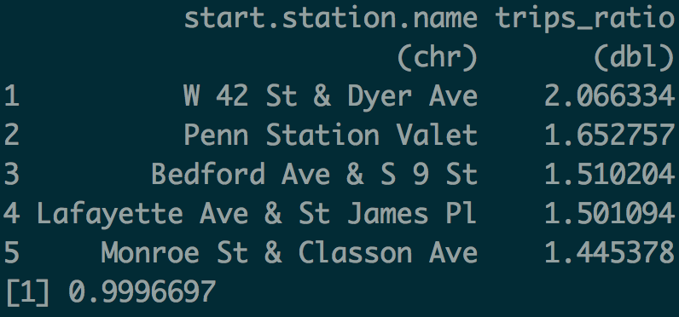

Slide 11
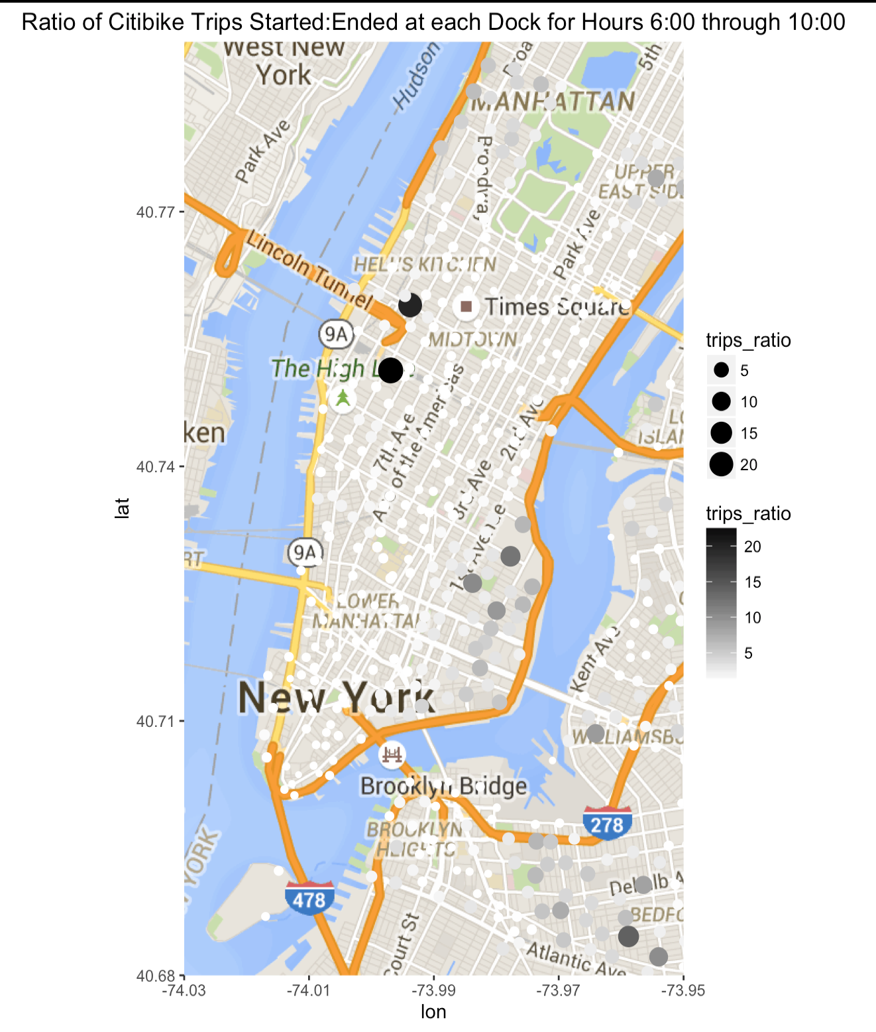
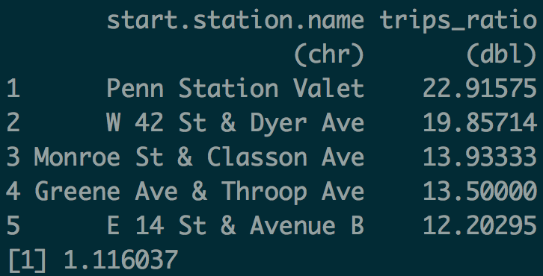

Slide 12
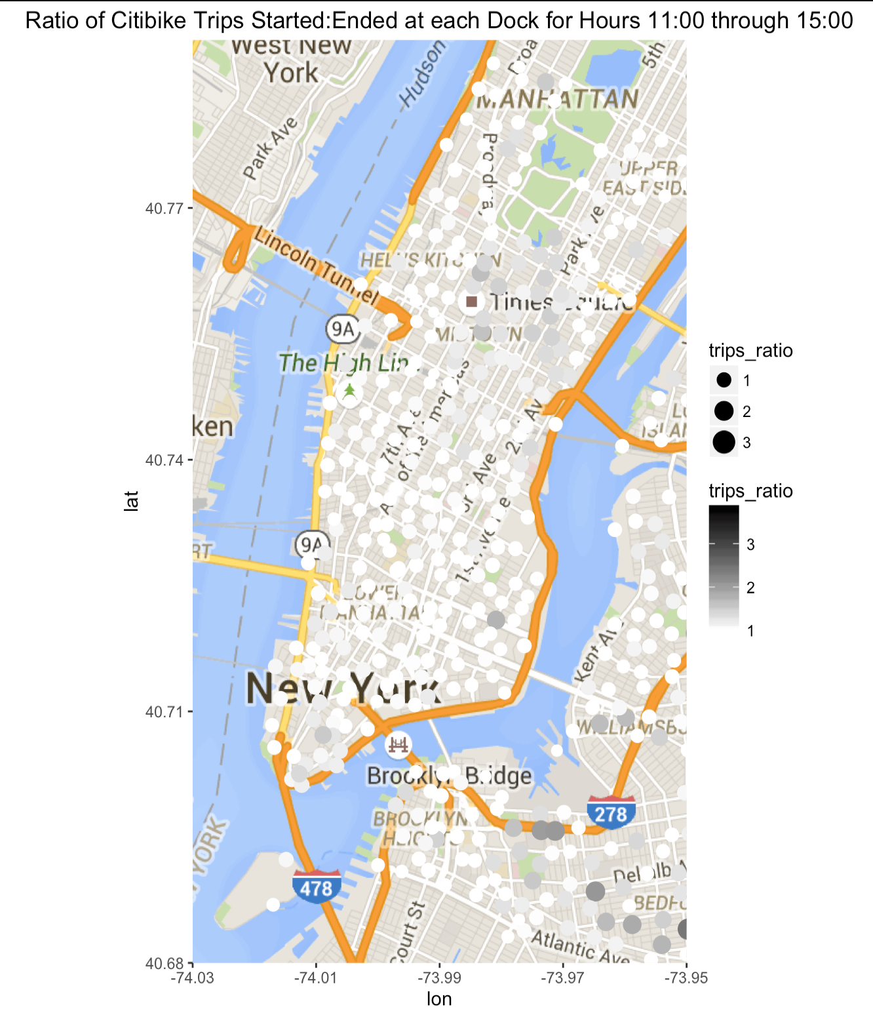
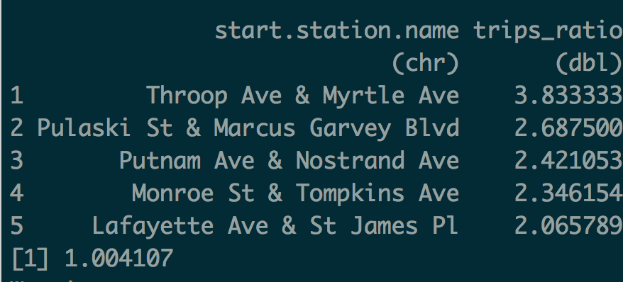

Slide 13
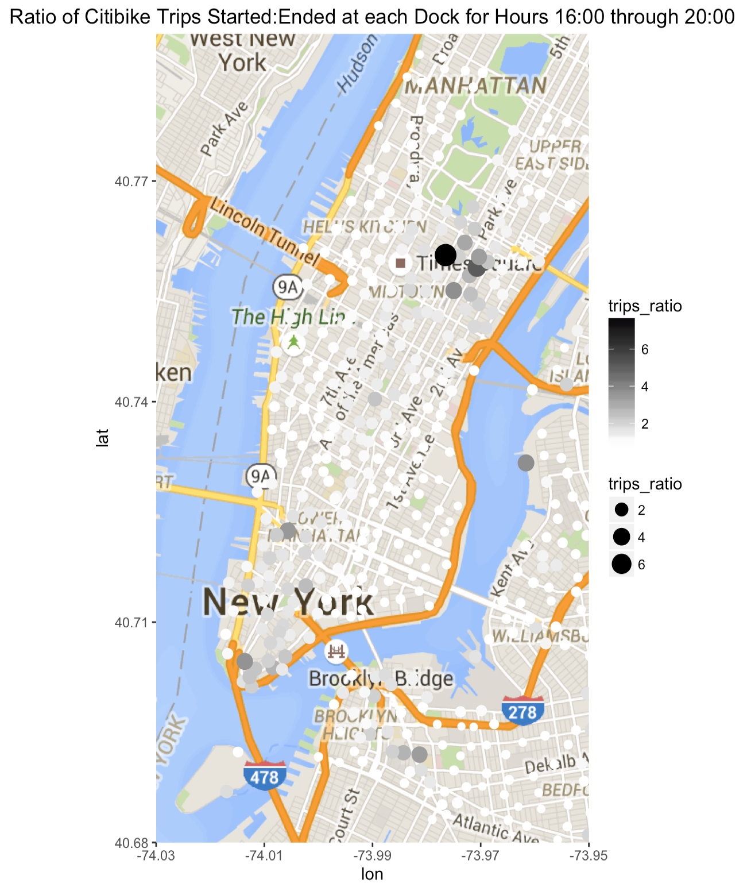
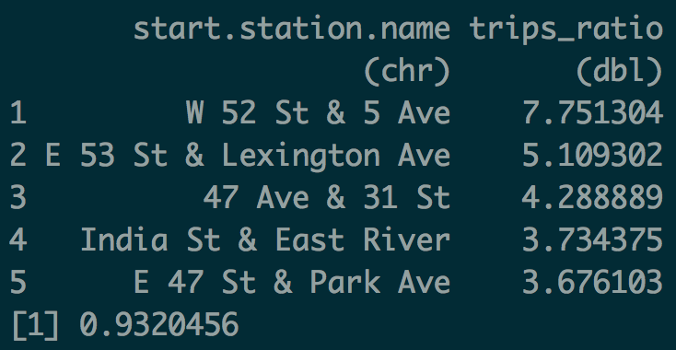

Slide 14
Some Conclusions
Weekdays vs Weekends
Neighborhood analysis (brooklyn, uptown residential neighborhoods, midtown commerce etc)
Flow disequilibrium arises around commuter times
Ratio plots: Large black dots appear during morning and evening, disappear during the day.
VERY significant individual points
Pershing Square North (Grand Central Area)
Penn Station Valet
Port Authority
Frequently transportation hubs

Slide 15
Problems
optimal scale settings for the color
mid-point setting?
optimal scale settings for the size
Should dot size represent the same value across plots?
Visualizing the distributions would help

Slide 16
With more time…
Same thing with end trips
Compare docks by revenue generated as well as activity.
Subscriber vs single payer patterns (commuters vs tourists?)
Do a similar analysis for weekEND data
Usage Patterns by Time of Year

